Slide 1
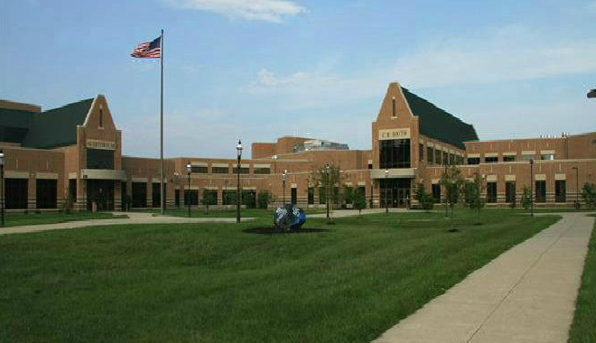
Program Planning 2020-2021

Slide 3
Scheduling Worksheet
Block | Quarter 1 | Quarter 2 | Quarter 3 | Quarter 4
1
2
3
4
Notes:
Use this slide to explain what a “Block” is

Slide 4
Block Scheduling
Four classes/day; approximately 90 minutes long
Classes meet for either…
1 marking period=9 weeks=1 block= .5 credits
2 marking periods=18 weeks=2 blocks= 1.0 credits
AP European History meets for 3 marking periods (1.5 credits)
AP Biology meets for 4 marking periods (2 credits)

Slide 5
Program Planning Process
Counselors present process to students
Teachers make recommendations for 2020-2021
Students input courses (academic, electives, and alternates) on student portal
Counselors meet individually with students to confirm selections

Slide 6
Important Dates
MBIT Open House/Parent Night (November 21st)
Curriculum Fair (Thursday, January 9th at 6:30 at CB South)
“Course Recommendation Day”…January 16th
MBIT Applications Due to MBIT by Feb. 28th
Verification Sheets Sent home on March 20th
Signed Verification Sheets Due on March 26th

Slide 7
January 16th
“Course Recommendation Day”
Teachers will discuss course recommendations with students and initial them on course request sheets
Students will receive a packet of information that contains:
Letter of Explanation of Program Planning Process
Directions for Online Student Course Registration
Course Request Sheet
Helpful Hints & Samples
During school, students will see videos about CB South electives options.
Students will enter courses into Student Portal at home from January 17th to February 9th.

Slide 8
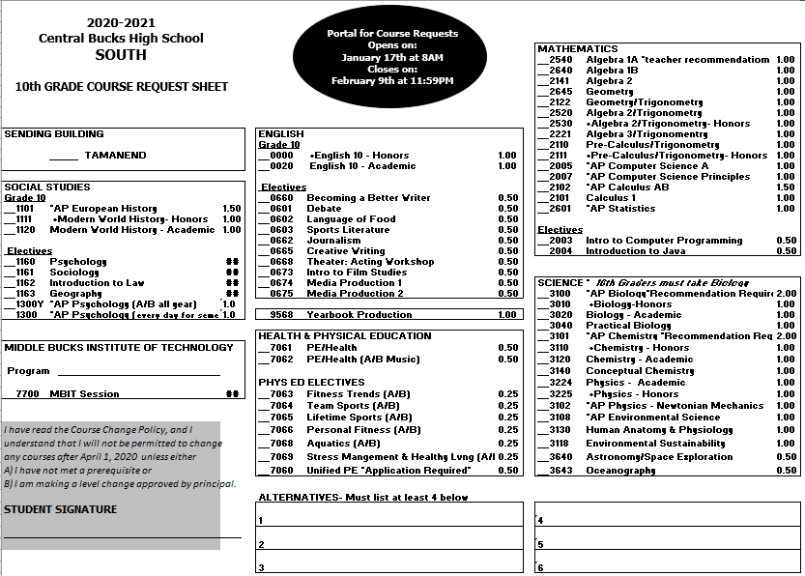

Slide 9
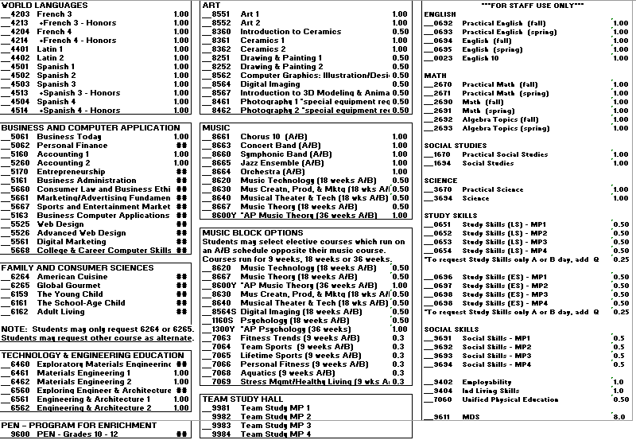

Slide 10
Verification Sheets…
Parents/Guardians should indicate any changes or questions
AND
Need to be signed
Courses can not be changed after this time

Slide 11
FYI…
Students need 27.25 credits for graduation
Honors level classes are weighted (by .25)
AP level classes are also weighted (by 1.0)
Performing Music Classes can be “blocked” with PE, Digital Imaging, Psychology, AP Psychology
(helps to avoid study halls)

Slide 12
Credits Required for Graduation
English → 4.00
Math → 4.00
Science → 3.00
Biology→1.0
Other Science→2.0
Social Studies → 4.00
Electives → 10.75
Wellness/Fitness → 1.00
Performance Assessments → 0.50

Slide 13
Diplomas
Standard = 27.25 Credits
Scholar’s = 28.25 Credits
(See Page 4 of Program of Studies for more details.)
---------------------------------------------------------------------------------------------------
**Upon leaving 9th grade, each student will have earned 6.75 credits, provided he/she passed each course and Success Plan.

Slide 14
Requesting Courses…
All students will take….
English
Math
Biology
Social Studies
Wellness
Electives/MBIT

Slide 15
Requesting Courses

Slide 16
Critical Course Change
Changes made only for the following reasons:
Deficiency in Prerequisites
Misplacement in Course
Any other requests can not be honored
Students and parents/guardians will sign that they understand courses can not be changed after April 1, 2020.

Slide 17
At the End of the Year…
Recommendations are reviewed for accuracy
Prerequisites are checked
Honors Courses
Math Courses
World Language Courses

Slide 19
Scheduling Worksheet
Block | Quarter 1 | Quarter 2 | Quarter 3 | Quarter 4
1
2
3
4

Slide 20
Academic Schedule
Block | Quarter 1 | Quarter 2 | Quarter 3 | Quarter 4
1 | English |  | Social Studies
2 | Math |  | Biology
3 | World Language |  | Wellness | Elective
4 | Elective | Elective | Elective | Elective

Slide 21
Academic Schedule (with music)
Block | Quarter 1 | Quarter 2 | Quarter 3 | Quarter 4
1 | English |  | Social Studies
2 | Math |  | Biology
3 | World Language |  | Elective | Elective
4 | Music (A/B Schedule/All Year) Wellness (A/B) Digital Imaging/Study Hall (A/B)

Slide 22
Academic/MBIT Schedule
Block | Quarter 1 | Quarter 2 | Quarter 3 | Quarter 4
1 | MBIT
2
3 | English |  | Social Studies
4
 | Math |  | Biology

Slide 23
Questions??
Tamanend
Mrs. Cammann
Mr. Klein
267.893.2910
CB South
Mrs. McGroggan
Mr. Hill
267.893.3000
MBIT
Ms. Hellwig
215.343.2480

